Slide 1
Implementation of SYMBOLIC MATHEMATICAL COMPILER WITH A GUI FRONT END
Created by: Aswene SIVARAJ
Notes:
final year project was to implement a symbolic mathematical compiler with a GUI front end.
To do this, I had to design and create a GUI that reads and evaluates an expression entered by the user. The programming language Python, was used to develop this application.

Slide 2
Background research
Graphical User Interface (GUI)
Graphical user interfaces use graphical icons such as widgets and buttons along with visual aids to interact with the user.
Benefits of GUIs include a user-friendly experience so people with basic computer skills can understand and interact with the application.
Before GUIs there were command-line interfaces which required commands to be typed (text-based interfaces).
GUIs have been adapted to handle touch and speech commands.
Tkinter is the standard Python interface.
Symbolic mathematical compilers
Symbolic compilers use algorithms and software to interpret and then manipulate mathematical expressions to provide precise results.
Advantages of it include exact computations as opposed to approximate floating-point values.
Uses LISP – List processing.
Other symbolic mathematical compilers aside from Python include MATLAB, Wolfram Alpha(WA)/Mathematica and Maple.
Notes:
Before designing the system, I researched into GUI’s, symbolic mathematical compilers and LISP. The purpose of using a GUI was to ensure the application is user friendly and easy to understand. In my research I found out about Python’s tkinter library which is used for creating GUI’s.
Looking at how current symbolic compilers such as wolfram alpha, MATLAB and maple work, I designed my application.

Slide 3
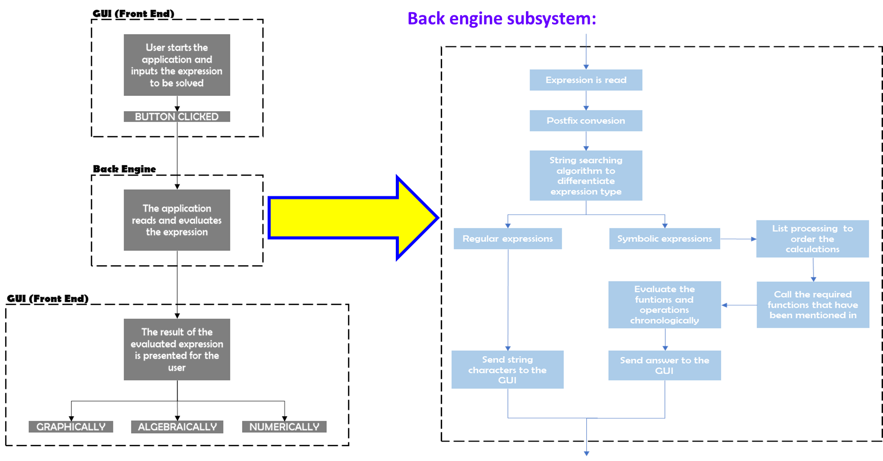
Architecture Design
Notes:
The designed system consists of a front end and a back end. The front end is what the user sees, such as the expression they enter and the result produced while the back end deals with reading the input expression, string matching the relevant operations and then carrying out the corresponding calculations.

Slide 4
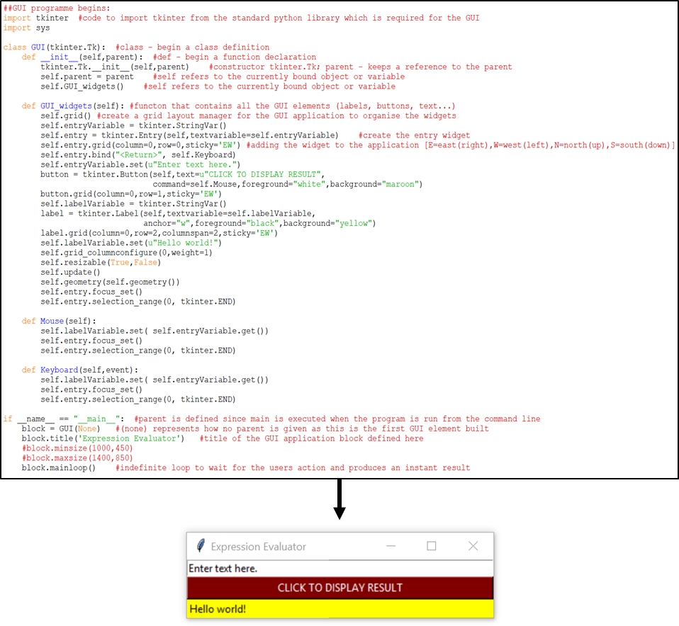
GRAPHICAL USER INTERFACE - GUI
START
Evaluate expression in back engine
Display result on front end
END
Import tkinter
YES
Button or keyboard pressed?
NO
Create window
Display widgets
Wait for user input
Notes:
The flowchart shows how the GUI operates. The tkinter module is imported and a blank window is created and then updated with the widgets. The application listens for a user input and waits until an event occurs to send the expression to the back end. The event would be a mouse click or a keyboard press. The back end then takes the expression, converts it to postfix and evaluates it.

Slide 5
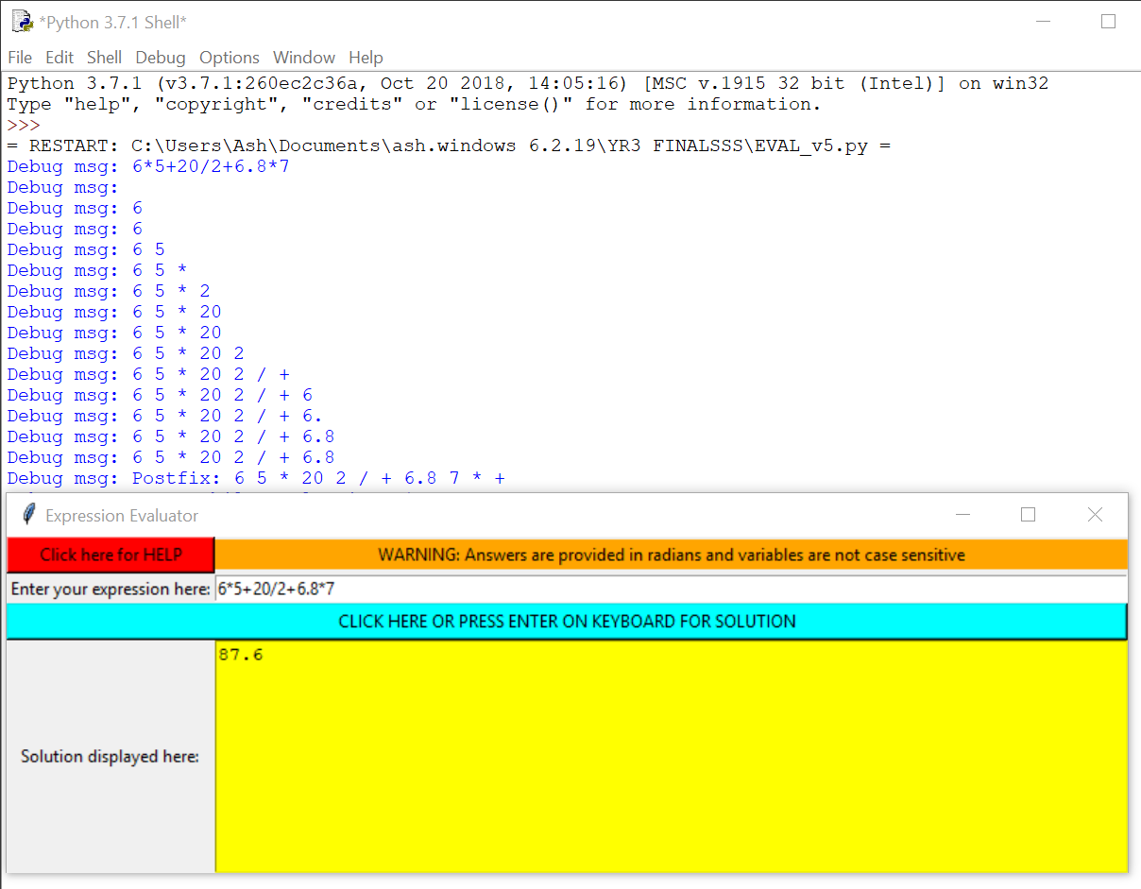
BODMAS
START
Scan user entered expression
NO
NO
Number?
Operator?
Brackets?
YES
YES
YES
Add to postfix expression
Push to stack (pop based on hierarchy)
YES
Left?
NO
Right?
YES
END – GO TO EVALUATION
Pop all elements till the left bracket
Notes:
Standard operations were implemented first and then their hierarchy was set based on BODMAS. To evaluate the expression, it is converted to postfix format and a defined stack stores the expression to be operated in the right order.
Image shows how the expression is converted to postfix and order it is evaluated from left to right.

Slide 6
MATH FUNCTIONS
START
Replace word with relevant operator
END
YES
User enters an expression
Word in operators?
NO
Word is the name of a variable
YES
Check character in the expression
Word built?
NO
Had to create a function in the code to account for case sensitivity and alternative formats of trig functions, i.e. cosine, sin, etc.
NO
Alphabetical?
YES
Build up “word”
Notes:
Next the math functions such as sin, cos, tan and their inverses and hyperbolics were implemented into the application. To evaluate these functions extra features had to be considered like case sensitivity (lower, upper or a mix) and alternative formats (longer versions).
As the functions are more than one character long, string matching was required so that the relevant parts of the string can be matched with the operator.
A separate function was created to account for the sine in cosine.

Slide 7



BINOMIAL EXPANSION
1
TWO METHODS:
PASCALS TRIANGLE
OR
FACTORIAL
1
1
1
2
1
Where, $\left(\begin{matrix}n \\ k\end{matrix}\right)=\frac{n!}{k!\left(n−k\right)!}$
1
3
3
1
Example: ${\left(a+b\right)}^{3}=\sum_{k=0}^{3}{\left(\begin{matrix}3 \\ k\end{matrix}\right)a^{3−k}b^{k}}$
$=\left(\begin{matrix}3 \\ 0\end{matrix}\right)a^{3−0}b^{0}$+ $\left(\begin{matrix}3 \\ 1\end{matrix}\right)a^{3−1}b^{1}$+ $\left(\begin{matrix}3 \\ 2\end{matrix}\right)a^{3−2}b^{2}$+ $\left(\begin{matrix}3 \\ 3\end{matrix}\right)a^{3−3}b^{3}$
$=1$ $a^{3}b^{0}+3$ $a^{2}b^{1}+3 a^{1}b^{2}+1 a^{0}b^{3}$
$=$ $a^{3}$ $+3$ $a^{2}b+3 ab^{2}+b^{3}$
Pascals triangle coded to determine the coefficients of the expansion:
Initialize the first row of the triangle, i.e. [1 1].
Take the sum of the above numbers for the next row.
Start and end of row are always 1.
N – represents power = number of rows.
Notes:
Further algorithms were implemented.
There are two methods to doing a binomial expansion.
One is the factorial method where you calculate the factorial which would be the coefficients of the expansion and write the result using the equation.
the other method is using Pascals triangle which is what I did. I created a function that initializes the first row of the triangle and all the other rows are summations of the above rowsvalues. The start and end of each row was assigned 1. the pascal triangle function creates the number of rows based on the users input – the power of the binomial.

Slide 8
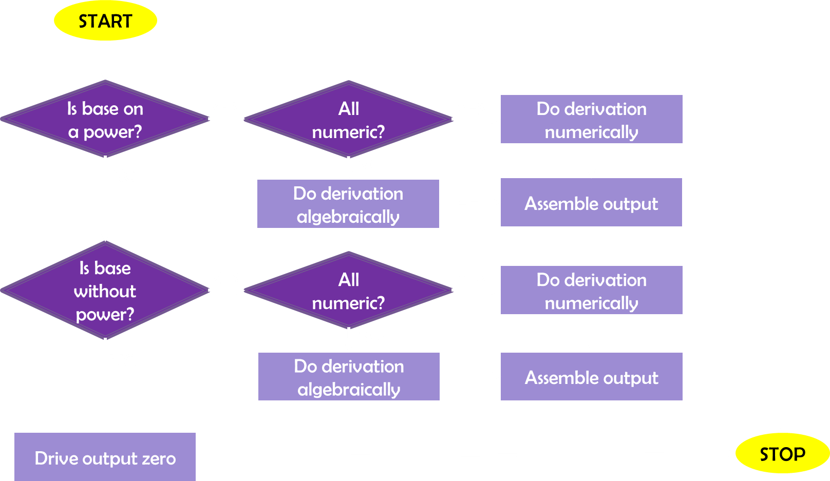
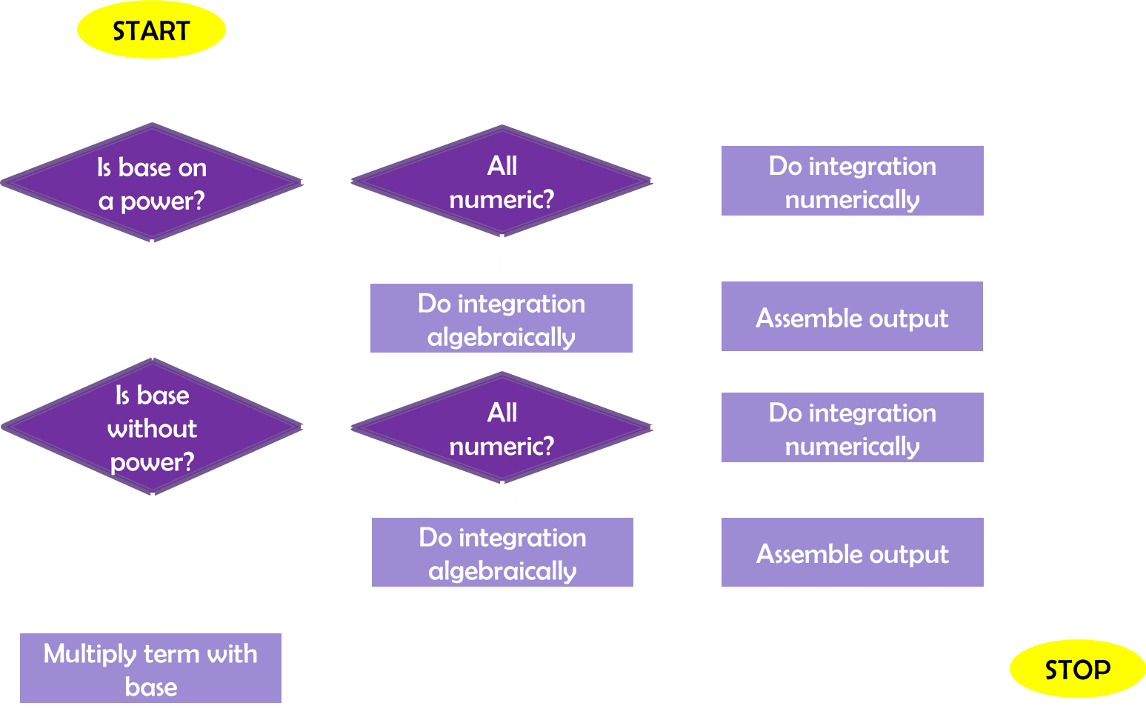


CALCULUS
INTEGRATION
$$x^{n}=\frac{x^{n+1}}{n+1}$$
DIFFERENTIATION
$$x^{n}=nx^{n−1}$$
Notes:
Other algorithms implemented were integration and differentiation.
Both had similar codes as the but while one multiplied with the initial power, the other divided by the newly calculated power. The flowchart shows their similarities except for when there is no indices.
An exception to integration would be handling a power of -1 as it would be logs but that feature has not yet been implemented.

Slide 9
Ethics & Enterprise
THE GOOD:
Software based project so no health and safety or environmental issues.
Accurate results.
Time saving device therefore increased efficiency, i.e.
Commercialized on a large scale as a mobile or computer application.
Teaching tool for institutions – compare hand calculations with a reliable source.
THE BAD:
Dependency – users become too reliant on the application.
Notes:
Run through points, give examples of dependency, i.e. kids are too reliant on applications that do their work for them so they cant even do the simple stuff anymore.

Slide 10

Conclusion: Results & Further work
Neater organisation of code, i.e. separate script files for each function
Widgets to let the user choose the mode of the results, i.e. radians or degrees.
Graphical features using MATPLOTLIB.
Further simplification of algebra.
Additional numerical approaches to calculations of integrals, differentiation and determining roots of polynomials, i.e.
Differentiation using the chain rule, product rule or quotient rule.
Integration by parts or substitution.
Polynomial roots for quadratic equations, cubic equation and higher powers.
Additional features such as a HELP window (command list for user) and a Debug function (help for the programmer) were created.
Notes:
Shows how the user enters an expression and clicks the button to evaluate it.
Examples of the current functionality of the application.

